Slide 1
Office 365 development
Speaker name

Slide 2
Deep dive into native iOS development with the Microsoft Graph
</>

Slide 3
Agenda
Intro
Azure AD Auth
SharePoint Lists REST APIs
Exchange APIs
OneDrive for Business APIs

Slide 4
Developer vision

Slide 5

iOS SDKs
SDK generated from OData CSDL
  Standard interface for all platforms
Dependency Injection optimized for each platform:
  HTTP clients, Async frameworks, JSON parsers
  Authentication with Azure AD Authentication Libraries
Industry-standard dependency manager support
  Cocoapods (Xcode)
Popular IDE Support
  Xcode
Open source end to end

Slide 6
App Developer
Add dependencies via Cocoapods
Start coding
  Add DependencyResolver
  Handle authentication using ADAL
  Create *Client class for services
  Navigate hierarchy

Slide 7
Getting Started
iOS

Slide 8
Tools
Xcode
  Create a new Objective-C iOS project
Cocoapods – http://cocoapods.org
Create a Podfile
  Run pod install
  Dependencies are resolved automatically
  Project is automatically updated

Slide 9
1
iOS
Authentication
with Azure AD

Slide 10
Overview
iOS ADAL
Authentication with O365 SharePoint
is handled by Azure AD
Azure AD supports OAuth 2.0 – Access tokens
and refresh tokens
The Active Directory Authentication Library (ADAL)
provides UI and services for implementing Azure AD
OAuth within an iOS app
Don’t expect to work with O365 APIs
without understanding ADAL

Slide 11
iOS ADAL
Authentication UI
Support for two-factor
Caching (automatic token refreshing, silent auth)
Secure (tokens etc. are encrypted in the cache)
1
Features
2
3
4

Slide 12
iOS ADAL
Create
AuthenticationContext
Call ADAL and acquire
token (may prompt user)
Setup DependencyResolver, add credentials
Create Client(s)
1
Authentication process
2
3
4

Slide 13
Where can I find it?
iOS ADAL
Supports both iOS and OS X
Can be included as source project,
or installed via the Cocoapods dependency manager
https://github.com/AzureAD/azure-activedirectory-library-for-objc

Slide 14
How do I use it?
iOS ADAL
If you are using Cocoapods to manage
dependencies in your Xcode project, add the following line to your Podfile to install ADAL for iOS
pod 'ADALiOS', '=1.2.4'

Slide 15
What else do I need?
iOS ADAL
Before continuing, you must register
your iOS app in Azure AD as a “native client”
app, and obtain a client ID
This client ID is passed to the ADAL along with
other information about your AD/O365 tenant

Slide 16
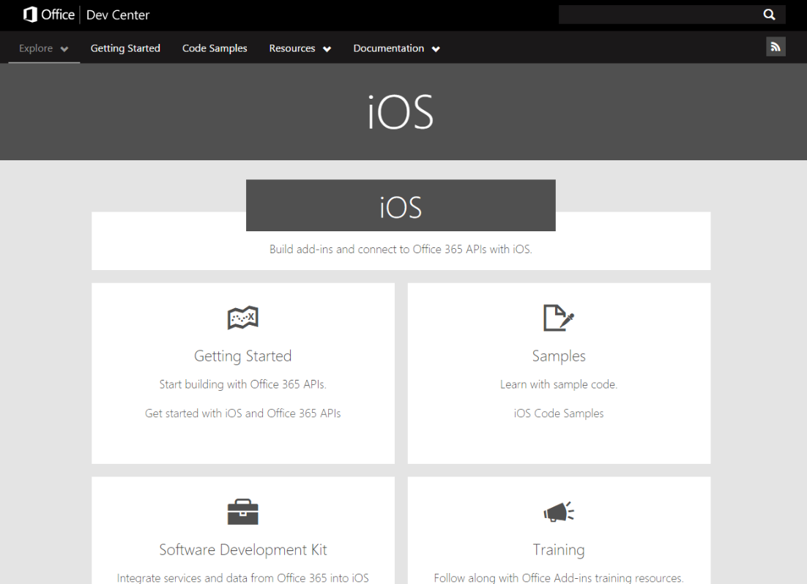
Examples
iOS ADAL
See: http://dev.office.com/ios

Slide 17
Securely storing tokens
iOS ADAL
While there are ADAL methods which accept
passing refresh tokens, we don’t need to use them
ADAL automatically caches access/refresh
tokens securely
Tokens stored securely using the iOS Keychain
Services API

Slide 18
AD Authentication https://github.com/OfficeDev/Property-Inspection-Code-Sample
iOS ADAL

Slide 19
2
iOS
Calling the O365 SharePoint lists API

Slide 20
iOS SharePoint lists
The O365 Lists REST API provides programmatic access to your Lists and List Items
in O365 SharePoint Online
Authentication is handled
by Azure Active Directory
Overview

Slide 21
What can I do with it?
iOS SharePoint lists
Lists
  Enumerate lists
  Enumerate list fields/columns
List Items
  Enumerate list items
  Create, read, update and delete list items

Slide 22
SharePoint lists https://github.com/OfficeDev/Property-Inspection-Code-Sample
iOS SharePoint lists

Slide 23
3
iOS
Calling the Microsoft Graph for Exchange API

Slide 24
iOS Exchange
The Microsoft Graph SDK for Objective-C provides programmatic access to your Mail, Calendar & Contacts in O365 Exchange Online
Authentication is handled
by the Active Directory Authentication Library
for Objective-C
Overview

Slide 25
Where can I find it?
iOS Exchange
https://github.com/OfficeDev/Office-365-SDK-for-iOS/
Install by adding to your Podfile:
pod 'MSGraph-SDK-iOS'

Slide 26
What can I do with it?
iOS Exchange
Folders and Messages
  Create, read, update and delete
  Send new messages
  Reply, reply all, forward messages
  Manage attachments
Calendars and Events
  Create, read, update and delete
  Calendar groups
  Send invites
Contacts
  Create, read, update and delete

Slide 27
Exchange https://github.com/OfficeDev/Property-Inspection-Code-Sample
iOS Exchange

Slide 28
4
iOS
Calling OneDrive
for Business

Slide 29
iOS OneDrive
The Microsoft Graph SDK
for Objective-C provides programmatic access to
files in in your O365 OneDrive account
Authentication is handled
by Azure Active Directory
Overview

Slide 30
Where can I find it?
iOS OneDrive
https://github.com/OfficeDev/Office-365-SDK-for-iOS/
Install by adding to your Podfile:
pod 'MSGraph-SDK-iOS'

Slide 31
What can I do with it?
iOS OneDrive
Files
  Create, read, update and delete files and folders
  Upload and download File contents

Slide 32
OneDrive for Business https://github.com/OfficeDev/Office-365-SDK-for-iOS/Samples/simple-drive-app
iOS OneDrive

Slide 33
Summary
Intro
Azure AD Auth
SharePoint Lists REST APIs
Exchange APIs
OneDrive for Business APIs

Slide 34
Further reading…
To get started
  http://dev.office.com/ios
ADAL
  https://github.com/AzureAD/azure-activedirectory-library-for-objc
Office 365 SDKs
  https://github.com/OfficeDev/Office-365-SDK-for-iOS

Slide 35
Developer Program launch
1 YEAR FREE
Email
Newsletters
Free Developer Subscription
Free
Training
Free
Tools
Webinars
http://dev.office.com/devprogram

Slide 36
Engage

